Slide 1


Session 1.3: LangChain &
Advanced Chunking
Orchestrating Semantic Data Pipelines for Enterprise AI

Slide 2



The Illusion of Infinite Memory
Strict Operational Limits
Quadratic Scaling: $O(n^2)$
LLMs operate within a defined Context Window. It is the active RAM of the neural network.
The "Attention Mechanism" compares every token to every other token. Compute power required doesn't double—it quadruples with input size.
Fatal Error: Feeding 128,001 tokens into a 128k window crashes the system instantly.

Slide 3

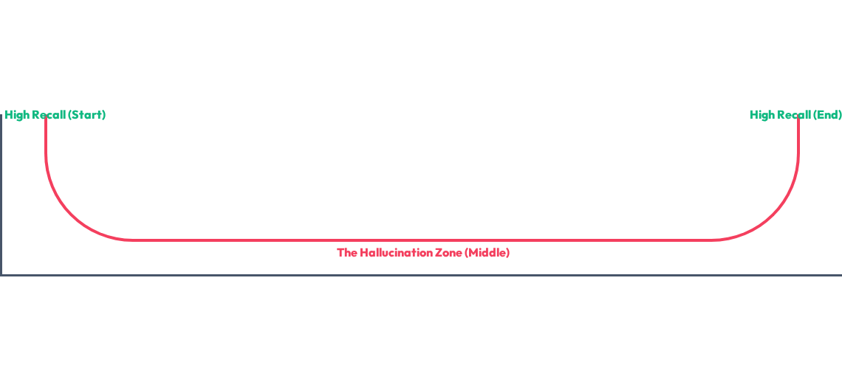
The "Needle in a Haystack" Gap
Large windows don't guarantee accuracy. Accuracy follows a U-Shaped Curve.
The Solution: Chop documents into small, clean, high-context fragments.

Slide 4





LangChain: The Orchestration Layer
Core Workflow
AI Plumbing
Standardized Python framework for building LLM applications. It handles the "glue code" between raw data and APIs.

Slide 5



The PDF Extraction Challenge
Coordinates vs Semantics
PyPDFLoader Solution
PDFs store "Bounding Boxes" (X/Y coordinates) for printing. They have no concept of "sentences" or "headers."
Parses visual structures into Document Objects containing:
open('file.pdf').read() returns raw byte gibberish.
•
page_content (Raw text)
•
metadata (Page #, Source)

Slide 6

Splitting Strategy Comparison
Technique | Logic | Risk
Naive Splitting | Split every N characters. | Slices words in half (e.g. "infra-structure"). Destroys context.
Recursive Splitting | Splits at Paragraphs, then Sentences, then Words. | Preserves semantic meaning and linguistic integrity.

Slide 7





Recursive Logic Hierarchy
The splitter attempts to split using these separators in order:
Recursion: If a paragraph is too big, it drops to lines. If a line is too big, it drops to words. It never cuts mid-word unless forced.

Slide 8


The Future: Semantic Chunking
Intent-Based Splits
Workflow
Uses AI Embeddings to measure the "distance" between sentences. It cuts the document only when the topic changes.
1.
Convert text to vectors.
2.
Calculate cosine similarity.
3.
Split where similarity drops below a threshold.

Slide 9
Solving the Boundary Problem
Why Overlap?
If you split exactly between paragraphs, you lose the "connective tissue." Chunk A gets the question; Chunk B gets the answer. Separated, they are useless.
The Fix: Force a 10-20% overlap (e.g., 200 chars). Chunk 2 "rewinds" into the end of Chunk 1.
Chunk 1: ...project lead is Tony.
Chunk 2: project lead is Tony. He is reviewing...

Slide 10


Metadata: The Identity of Data
Avoiding "Context Soup"
{
When you shatter a document into 1,000 fragments, they lose their identity. Metadata ensures Traceability.
'source': 'Q4_Report.pdf',
'page': 14,
'author': 'Jaymin',
Attach page numbers, source URLs, and department tags to every chunk.
'category': 'Audit'
}

Slide 11


Advanced Metadata Engineering
Metadata isn't just for citations; it's for Pre-filtering in search.
Temporal Filtering
Departmental Bias
Filter chunks based on document_date to ensure the AI doesn't use outdated policies from 2021.
Restrict search space to dept: Engineering to prevent finance-related noise in technical queries.
"Garbage In, Garbage Out. Metadata is the filter for garbage."

Slide 12



The Hands-On Lab: End-to-End Pipeline
# 1. Load Document
# 3. Inject Enterprise Metadata
loader = PyPDFLoader("Audit.pdf")
for chunk in chunks:
pages = loader.load()
if "BUDGET" in chunk.page_content:
chunk.metadata['category'] = "Finance"
# 2. Configure Splitter
splitter = RecursiveCharacterTextSplitter(
chunk.metadata['project'] = "AuditQ4"
chunk_size=1000, chunk_overlap=200
# Result: Shattered text is now a
)
# traceable, tagged enterprise asset.
chunks = splitter.split_documents(pages)

Slide 13

Session 1.3 Complete
Foundation built. From quadratic compute limits to surgery-grade document chunking.
Next Step: Inserting these chunks into a Vector Database for Semantic Search (RAG).

